Slide 1
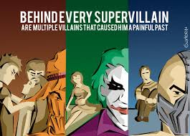
Supervillains

Slide 2
Definition
A villain who is super?
An individual or entity that commits evil acts in an extraordinary way?
A reversal of the definition of the superhero?
***supervillains precede the creation of the superhero genre
The supervillain trope belongs to many genres so it is limiting to use the superhero definition as the basis for defining
Definition can be developed from three elements (operate differently that with the superhero: Mission; Powers; identity

Slide 3
The Supervillain
One of the key markers / tropes of the superhero genre
But supervillains are not unique to the superhero genre
A defining element of the superhero
Inverted image of the superhero
They have to be “unusual, exciting, provocative and surprising” (Stan Lee)
Just as a superhero represents the values of a society or culture, the supervillain represents the inversion of those values
A superhero needs a supervillain to fight; to exist even

Slide 4
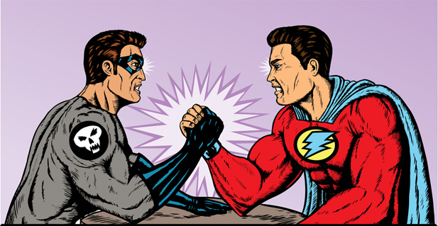
Classic Confrontation of Hero & Villains

Slide 5
behind this Confrontation: same Old Story
A fight for love and glory
A case of do or die…
We want the hero to win (what usually happens)
We want a lot of “collateral suspense”
We want a nail-biting fight
The villain must outclass the hero; be virtually unbeatable
The more unstoppable and terrifying the hero, the more satisfying the heroic victory (Chris Claremont)
Both hero and supervillain are motivated

Slide 6
The Five Types: 1. The Monster Based on Peter Coogan’s Superhero: The Secret Origins of a Genre
Oldest type; figures as the inverse of humanity; beastly inform;
Eg. Humbaba or the Bull of Heaven;
When a monster has a human form, it is monstrous morally—no sense of right or wrong, which is symbolically expressed by the monster’s lack of a soul
Eg. Frankenstein’s monster-lacks a soul

Slide 7
2. The enemy commander
Represents alien societies whose values are at odds with those of the culture producing the stories
Not viewed as villains in their own lands
Has the resources of the state behind him;
in a position of legal authority in that society;
he might be the king, tyrant, dictator, the power behind the throne, military commander
Darth Vader, Milton’s Satan, Dr. Doom, Hitler

Slide 8
3. The mad scientist
Excessive pursuit of knowledge; fails to see the moral dimensions or implications of his experiments; obsessive behaviour; motivated by revenge
Employ dangerous and unorthodox methods
Dr. Victor Frankenstein, Dr. Faustus, Lex Luthor
“In his quest for insight into the laws of nature, however altruistic, the mad scientist, too often misinterprets or altogether fails to perceive the full moral dimensions of his experimentation” (Peter Goodrich)

Slide 9
4. The criminal mastermind
Professor Moriarty of Sherlock Holmes mysteries; Joker; Riddler; James Bond villains
Intellectual prowess—sets traps for the detective or hero
Dates back to the detective story and the metagenre of crime fiction—fascinating and worthy adversary for the great detective
Sets rules of the game and displays a sense of humour about them
Values his adversary’s life b/c he played with an equally skilled opponent brings him great gratification
He values his adversary’s life b/c playing with an equally skilled opponent brings him great pleasure

Slide 10
5. Inverted-Superhero supervillain
Limited to superhero genre (this claim is questionable)
Identified by antisocial and selfish mission; identity expressed through superpowers, code name, and costume
Catwoman and Joker two of the earliest and most important ones b/c they are a direct response to the superhero by the creators who wanted to expand the genre
Mission comes from a personal defect in the character before he/she gains power (a character flaw—power just magnifies that flaw)
This defect is what prevents transformation into hero—instead they seek revenge for the wrongs done to them

Slide 11
Inverted-superhero supervillain cont..
*******What makes this villain different than others is that they can become superheroes
(“Catwoman is Back” in The Greatest Stories joins Batman and Robin); they can be reformed)
Marvel’s supervillains who join the good guys: Hawkeye, the Black Widow, Quicksilver, the Scarlet Witch, and even Sandman

Slide 12
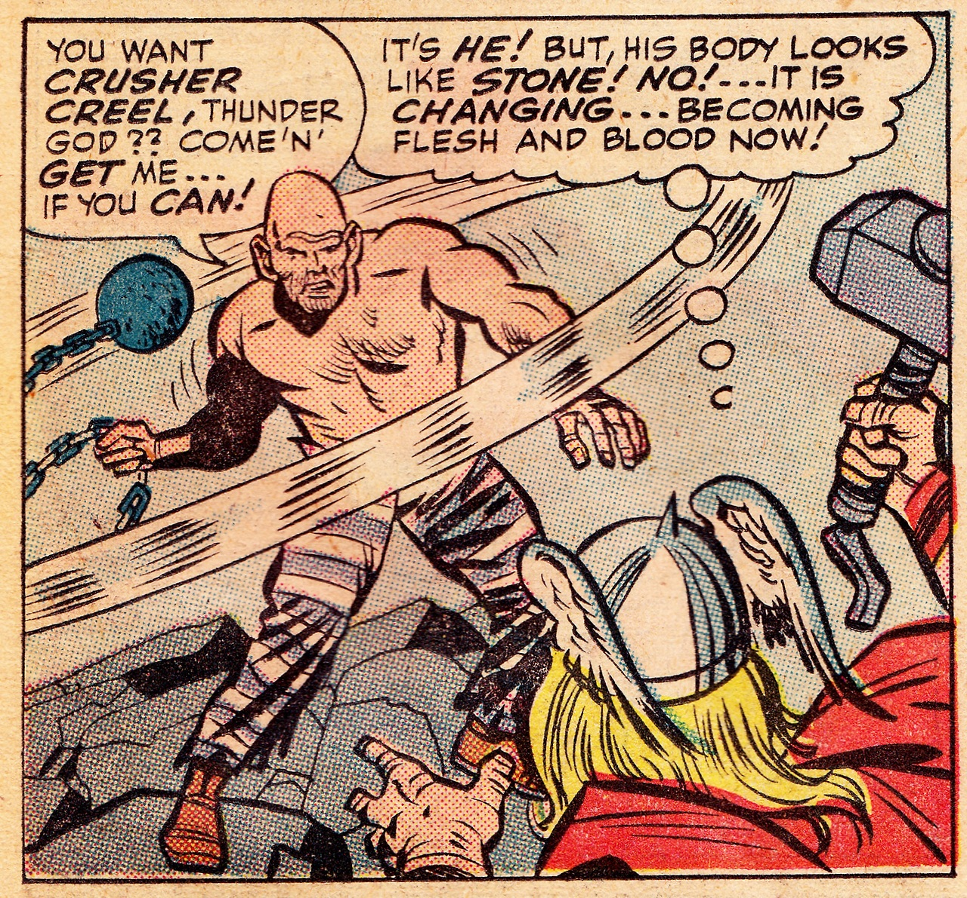
Four sub-types of supervillains
The alien (can be any of the 5 main types)
The evil god (unlimited supernatural power but act in evil); Loki is both an evil god and inverted-superhero supervillain
The femme fatale-sexual allure: Black Widow and inverted-superhero supervillain until she became a superhero
The super-henchman—underlings with superior abilities (Fat Bastard in Austin Power-serves under Dr. Evil; The Absorbing Man)

Slide 13
Key Aspects that define a supervillain:
1. Mission
Motives are purely selfish, anti-social mission
Seeks something—wealth, power, fame,--that serve his interests
Let me tell you what I’m thinking about, sweetie, I was in the bath one day when I realized why I was destined for greatness. You know how concerned people are about appearances. This is attractive, that is not. Well, that’s all behind me. I now do what other people only dream, I make art until someone dies. See? Hee, hee, hee. I am the world’s first fully functioning homicidal artist. (Joker)
He sees his crimes as art; his destruction to mankind is seen as an act of art
He transforms the unhappy living into the eternally smiling dead

Slide 14
2. Mania
Raises the supervillain above the common criminal
Allows the supervillain to see what he/she is doing as art or as a great accomplishment
Grandiose, self-aggrandizement
Does not see the inhumanity of what he does
Perceives his actions as beneficial to the world; driven by ego
Mission to save society from itself is an example

Slide 15
3. The wound
Grandiose identification comes from a sense of victimhood
Originates from a wound the supervillain never recovers from
Creates a superiority complex; as a defense mechanism from sense of inferiority and insecurity from childhood
Supervillains are often defective physically or socially, but superior mentally
Eg. Dr. No blames all on his parents-cannot forgive them
Luthor’s wound: loss of his hair
Joker: this mania (based on his wound) is an understandable reaction to the events of the universe--his way of imposing meaning on a world void of any meaning at all.

Slide 16
4. Power
Without power, these individuals are merely villains (strong, resourceful, cunning but villains)
More powerful than ordinary authorities
They have cunning, genius, resources, extra-ordinary abilities that surpass the power of the law
Sources of power:
Science & technology: Superiority related to super-science or technology not available to the rest of society
Sometimes mystical or magical powers (looked upon as sorcerer)
2. Wealth
3. Charisma: draws people to serve them
4. extra-ordinary physical, mental, or mystical abilities: that make them more than human (often similar to any of the powers possessed by the superhero)

Slide 17
5. Identity
Weakest element of the definition
Wear costumes and have codenames like the superhero
Unlike superheroes, they do not usually have a secret identity
Give up their ordinary lives; cut themselves off from the normal
They abandon the things that tie them to mundane existence
Superhero adopts a secret identity to maintain links to ordinary society he protects; supervillain abandons his ordinary identity to disconnect from society he attacks
Names: a villains name often raises him above ordinary criminals—heightens the sense of power and grandiosity

Slide 18
Hero/Villain Relationships
Supervillains get their sense of worth/validation from the quality of hero they oppose
Relate in 5 key ways:
Arch enemy
Dopplegangers
Oedipal relations
Displacement of hero’s personality
Rogues gallaries

Slide 19
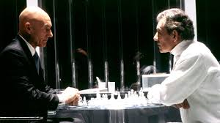
1. Arch Enemy
Villain is the hero’s greatest opponent
Frequent confrontations
This relationship always sheds light on the nature of the hero
The hero is what the villain is not—resistance of the defect
Different pathways
Peaceful integration vs violent opposition
Similar goals
Selfless vs selfish

Slide 20
2. The Doppelganger
German for the “double-walker”
http://doppelgangerdefinition.com/ : Derived from the German word ‘doppel' meaning ‘double' and ‘ganger' meaning ‘walker'. Doppelganger is, therefore, an apparition of oneself or someone whom we are aquainted with and even someone whom we have never met before. . . . [T]he word is used as a synonym for ‘alter ego', ‘evil twin', ‘clone', ‘duplicate' ‘mirror image' and such other words.(not all are evil though)
Famous Dopperlgengers: Frankenstein/monster; Jekyll/Hyde; Superman/Kent; Darth Vader/Anakin Skywalker the good Jedi; Fight Club; Gilgamesh and Enkidu
Depicts a “conflict within the soul” or the struggle between good and evil; virtue and vice within the individual
Freudian Analysis: “return of the repressed”—the hidden or repressed aspects of the personality
Death of the Doppelganger represents the repression of the dangerous impulses, but the struggle leaves the protagonist sadder and wiser about humanity and about himself or herself.

Slide 21
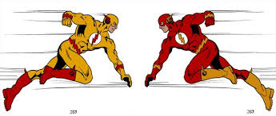
Doppelganger
A villain with the same powers and often a similar visual look
These villains present the toughest challenge to the hero as they are not bound by a heroic code
Another kind (opposite kind) reverses the powers and appearance of the hero

Slide 22
3. Oedipal
Oedipal villain has a Freudian relationship with the hero
Represents the hero’s relationship with his parents
For example, Superman’s battles against versions of his father
His origin story is Oedipal
Rejected by Lara for Jor-el; abandonment issues
Very ambivalent relationship with his father
According to this theory, Clark is an outward expression of Superman’s inner self

Slide 23
4. Displacement
Supervillains represent a displaced aspect of the hero that the hero struggles with
“The great Batman villains all mirror some key point in Batman’s character, a point of reference which gives their villainy special purchase within the metatext of the Batman myth” (R. Reynolds)
Lost a part of himself when his father dies
Bat identity is a mantle to his father
He has to repress that memory in order to be Batman
The villains represent Bruce’s ID—what would happen if Bruce got out of control; did not practice restraint
Keep the “beast” within suppressed (TDKR—he cant suppress it)

Slide 24
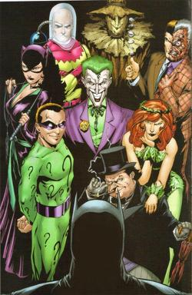
5. Rogues Gallery
The Rogues Gallery is a band of colorful and numerous recurring villains that show up to torment the hero over and over again
Team up in various combinations against the hero
They usually have a unifying theme that tells us something abt the hero
One villain in the gallery usually stands out as the hero’s arch enemy

Slide 25
Proactive / Reactive
1. Plot Level:
The tension: Villains are proactive; Heroes are reactive
Supervillains drive the plot with their master plans
Hero reacts to the plan, which justifies the villain’s violence and evil
2. Level of genre:
the convention is that the villain is reactive
Supervillains are created in reaction to the hero and his ability to defeat the ordinary criminals

Slide 26
Evening Contemplation:
Bat as good and clown as bad?
Why so?
Unusual narrative dynamic

Slide 27
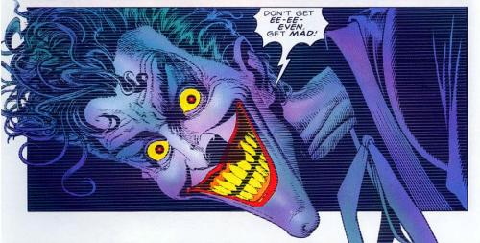
Batman: The Killing Joke

Slide 28
Approach
Considered one of (if not the) most revered Batman books ever written
Greatest, most “definitive” Joker stories ever told
Sets up his utter depravity and pathos
Gives him a backstory (origin story)
The man behind the smile
Make Joker more real, more terrifying

Slide 29
New Delux Edition (2008)
Remake of the original 1988
Marks 20th anniversary
Publication coincides with the Dark Knight
Has received criticism by Moore himself
Moore describes it as “clumsy, misjudged and devoid of real human importance”
Criticism: Barbara Gordon’s treatment is incredible violent and distasteful
Morally ambiguous ending not in keeping with the rest of the book

Slide 30
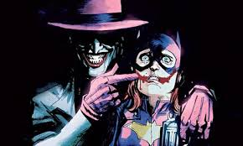
No laughing matter

Slide 31
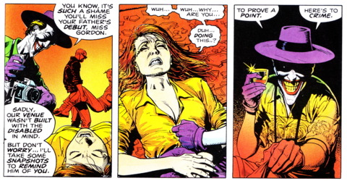
Misogyny

Slide 32
Art Work (Brian Bolland)
Bolland known only for his cover work
This was his last internal artwork; he went back to focusing on cover art
Nobody draws the Joker like him (see the Joker’s first reveal)
Stroytelling uses very crisp lines
Very expressive; lots of definition (excessive)
Cool colour tones in the delux version
In the original version, colorist John Higgins was brought in to take over b/c Bolland worked too slow; he was still sketching
Bolland was disappointed with Higgins not living up to his vision with the tone
So he was happy to have the opportunity to do the delux edition

Slide 33
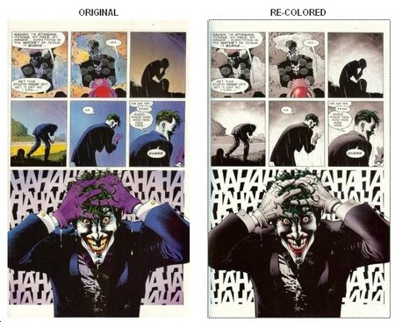
Differences in artwork

Slide 34
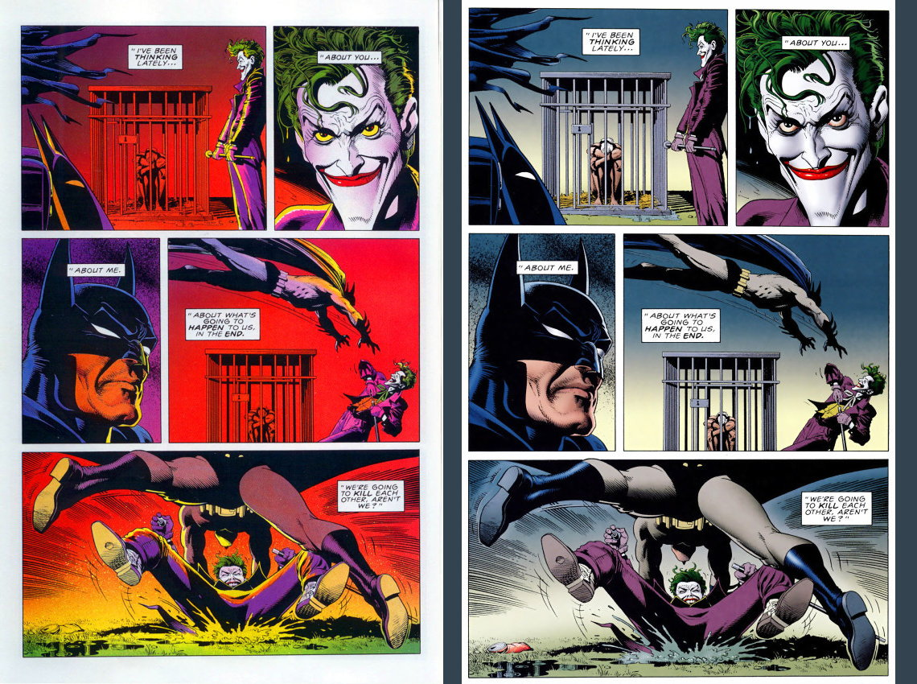
Colouring Differences cont’d

Slide 35
√ “You’re just a freak like me”
Why is their dynamic so fascinating?
Joker’s character draws attention to the blurred distinction between the madman and the madness of the outside society. This theme is explored in Nolan’s films; The Killing Joke; and TDRK
This theme draws attention to the more sinister potential of the superhero myth

Slide 36
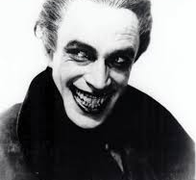
The Man Who Laughs
Influence: 1928 silent movie adaptation of Victor Hugo's "The Man Who Laughs, about tormented soul with a garishly immobile smile that had been carved onto his face as a child.

Slide 37
Joker Evolution
Earlier Joker: Mass killer, no reason for killing except to bring anarchy to the world
Eventually identity shifted into a more cruel, creepy, and psychotic Joker---Joker as a dark reflection or inversion of the superhero
He is highly intelligent; plans his operations and is always two steps ahead of Batman (“The Joker’s Five Way Revenge”)

Slide 38
Joker’s View of the World
Life is madness, random, pointless; meaninglessness of existence
Setting: carnival (a world upside down)
To the Joker, his mania is a reasonable and understandable reaction to the universe-his way of imposing meaning onto the void
Joker’s origin story: one bad day will drive anyone mad—he believes that to this end, he is just like everyone else
He accuses Batman of having a similar bad day and going mad
To the Joker, Batman pretends that there is point to struggling
He will not submit to conventional morality—he rubs it in

Slide 39
Setting: carnival
A world turned upside down
Site of anarchy
A time during which rules are abandoned
Chaos is acceptable
festive space; A site of laughter and revelry (sex, dancing, feasting, singing)
A playful domain; separated from the “rational” world of the real (the sensible world)
A site and celebration of community
Inverts and suspends the hierarchies of official world
Also a world of circus freaks; of marginals; rejects of society

Slide 40
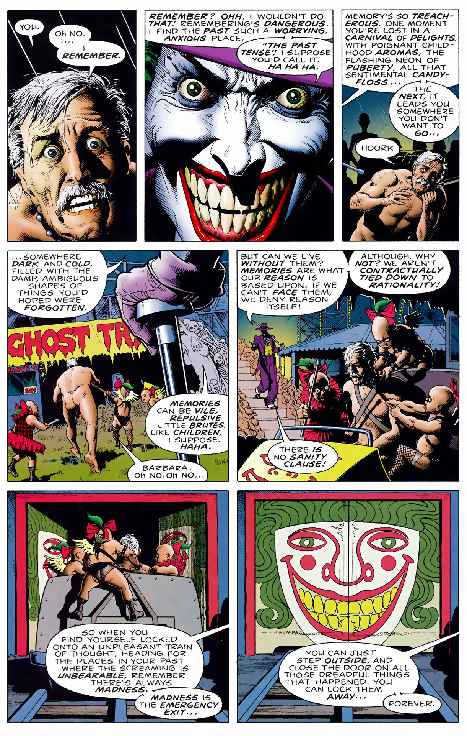
Gordon enters Joker’s mind
Page is juxtaposed to Joker’s memory
Flashback to his trauma, not Gordon’s
Why?
Read the visual elements
Note the shift in coloration

Slide 41
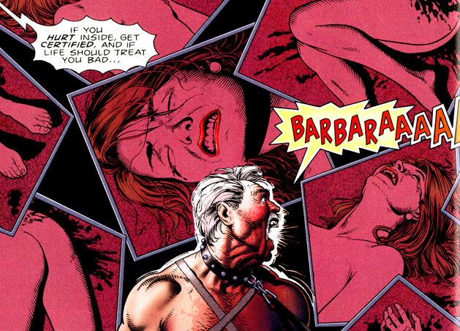

Slide 42
Madness versus Rationality
Joker monologue from The Killing Joke:
https://www.youtube.com/watch?v=OmucitZ0WSg

Slide 43
Setting: Amusement park
An ironic site
A site of memory (typically happy memories)
Joker turns into a site of traumatic memory
Interiority of Joker’s mind
Trying to invade and penetrate Gordon’s psyche with trauma
Monologue-expresses his attempt at mind control
Joker as voice-over
Avoids confronting Gordon face to face—scarier that way
Mind control works better that way

Slide 44
Joker: “not playing with a full deck”
Deeds are absurd and violent and utterly ghastly
His deeds are unimaginable awful, not just criminal
Actions are morally abominable
Laughing gas; permanent smile—his trademark techniques
Is he morally responsible?
Are genuinely insane people morally responsible?
He displays values that are genuinely disturbed—he treats people as objects
He lacks a sense of self-preservation
Once he went mad, is it safe to assume that he no longer operated out of free will?

Slide 45
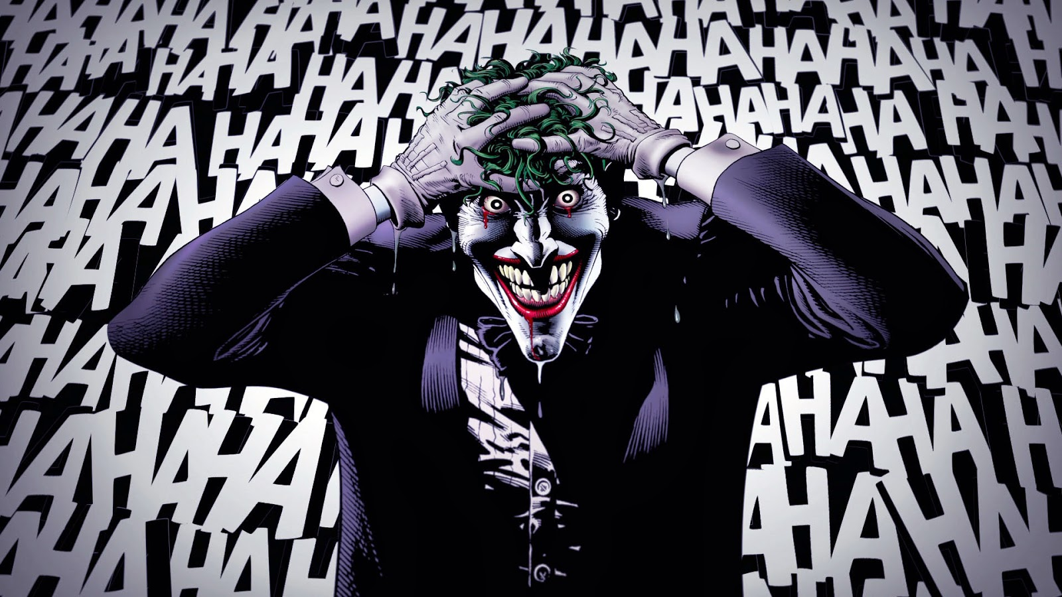
The Killing Joke: Emphasis?

Slide 46
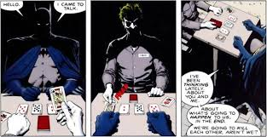
Joker/batman

Slide 47
Joker and Batman (duality)
Joker wants the approval of Batman. Why?
The respect and approval of the hero is needed to justify the supervillain’s existence and villainy
But the hero never gives it which is why the relationship persists
The rejection leads the supervillain into error that leads to his capture or loss, reinforcing the superiority of the superhero
How does Batman/Joker dyad complicate this? Do you agree or disagree?

Slide 48
Batman Killing the Joker: “who has the last laugh”?
A) Why he should kill Joker:
Batman is morally obligated to kill the joker (Tariq Moosa)
It would maximize happiness and the betterment of society
B) Why Batman shouldn't’t kill the Joker:
Batman's code of conduct isn't an arbitrary set of rules that can be broken or bent in service to a higher power -- it is the higher power. Batman has resolved that killing is wrong, and so not killing is an inviolable imperative.
Society should execute him, not Batman-breach of society’s structure

Slide 49
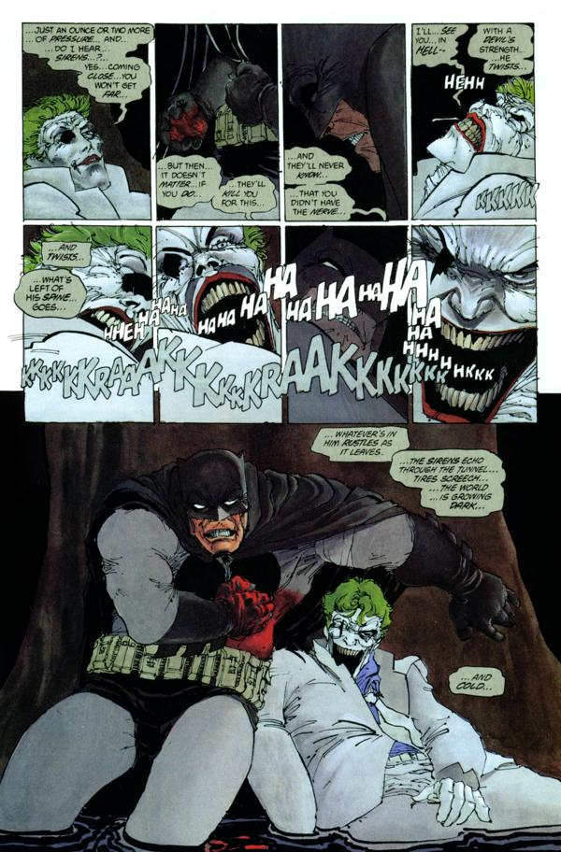
Issue central to the relationship: Joker’s claim to or capacity for reformation and rehabilitation

Slide 50
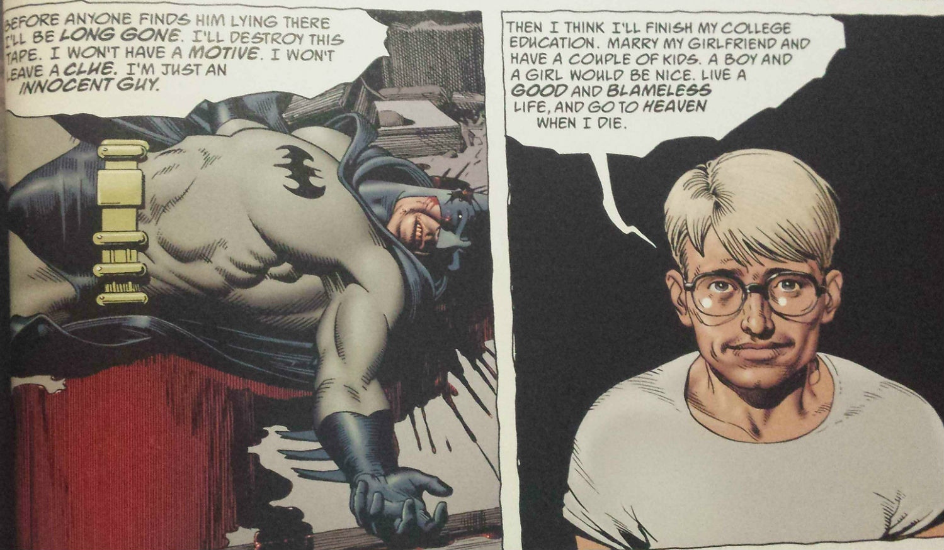
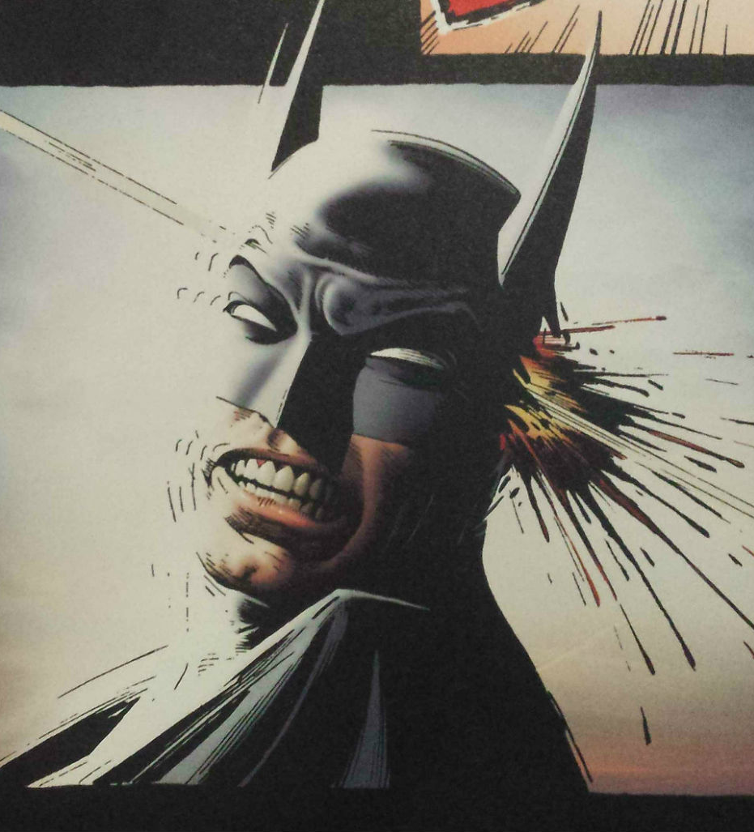
Epilogue (?)

Slide 51
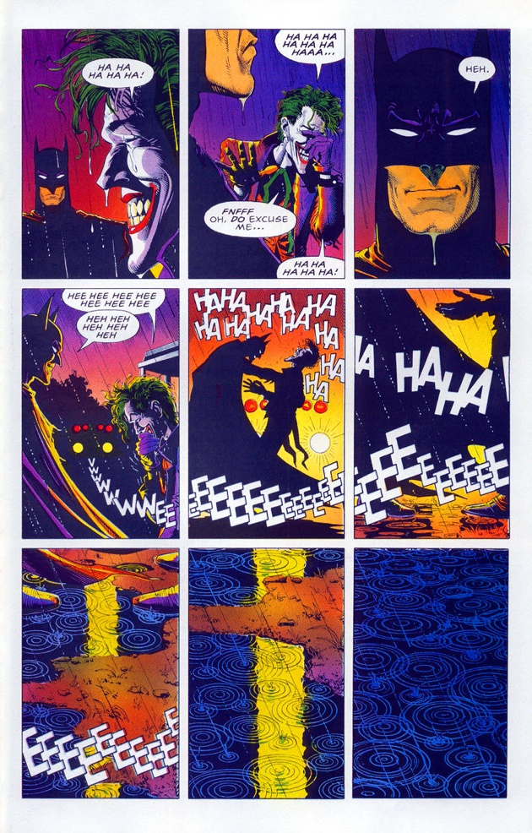
The Final Joke: (Ending of The Killing Joke)
Ambiguous ending
Does Batman kill the Joker?
http://comicsalliance.com/batman-killing-joke-ending-grant-morrison-alan-moore-brian-bolland-dc/

Slide 52
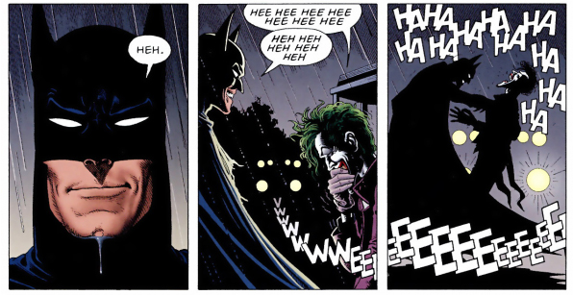

Slide 53
Epilogue
Follows the ending it with a short story
This story is meant to explain what really happens after the ambiguous panels
Everyday innocent good guy expresses his fantasies to do an epic evil deed

